Slide 1


Late Purushottam Hari (Ganesh) Patil Shikshan Sanstha’s
Mauli Group of Institution’s
College of Engineering and Technology Shegaon.
Project Name:
Design & Implementation of Crops Diseases Prediction using Deep Learning
Submitted By :
1. Sham A. Johari
2. Prerna S. Dabhade
3. Pallavi G. Tayde
4. Megha R. Chopade
5. Sanjay V. Junare
Guided By : Dr. P. M. Hasabnis
Department of Computer Science and Engineering
Session:2023-24

Slide 2
CONTENTS
Introduction
Literature Review
Technologies
Dataset Descriptions
Flow Diagram
CNN in Crop Identification
Image Augmentation
Steps
Advantages

Slide 3
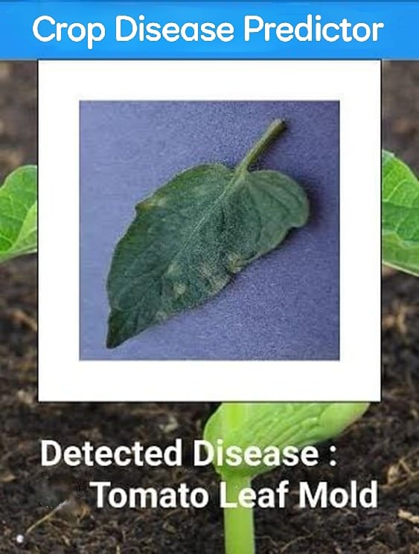
INTRODUCTION
In todays world, the agricultural sector has been increasingly advancing to overcome the challenges posed by crop diseases.
Deep learning holds immense potential for detection and prediction of crop diseases.
Our model aims to create a robust and efficient system capable of predicting crop diseases.

Slide 4
LITERATURE REVIEW
Author | Title of Paper | Remark
Kalpesh Shinde and Anand Khatri (2022) | “Crop Prediction and Plant Leaf Disease Prediction Using Deep Learning ” | This paper gives appropriate idea to identify plant leaf sickness.
Omkar Kurkute and Nikhil Raje (2020) | “Plant Diseases Detection Using Deep Learning” | Plant leaf images will be used to check for plant diseases in early stages.
Rajab Ali and Depali Nayak (2019) | “Crop Diseases Detection using Deep Convolutional Neural Networks” | This paper proposed Crop Disease Detection using CNN System based on Deep Learning.

Slide 5
TECHNOLOGIES
Hardware : RAM 12 GB, Storage 100 GB SSD, GPU 15 GB, Strong Internet Connection
Software : Operating System: Windows 10 /11
IDE: Jupyter Notebook or Google Collaboratory & Android Studio.

Slide 6
DATASET DESCRIPTION
Crops Types | Disease Class | Total Sample
Cauliflower | Cauliflower__Bacterial_spot_rot | 510
 | Cauliflower__Black_Rot | 502
 | Cauliflower__Downy_Mildew | 582
 | Cauliflower__Healthy | 744
Corn | Corn___Cercospora_leaf_spot Gray_leaf_spot | 500
 | Corn___Common_rust | 513
 | Corn___Healthy | 643
 | Corn___Northern_Leaf_Blight | 504
Potato | Potato___Early_blight | 679
 | Potato___Healthy | 627
 | Potato___Late_blight | 551
Rice | Rice__Bacterial_leaf_blight | 542
 | Rice__Brown_spot | 956

Slide 7
DATASET DESCRIPTION
Crops Types | Disease Class | Total Sample
Rice | Rice__Leaf_smut | 564
 | Rice___Healthy | 633
Tomato | Tomato___Bacterial_spot | 678
 | Tomato___Early_blight | 605
 | Tomato___Healthy | 599
 | Tomato___Late_blight | 619
 | Tomato___Leaf_Mold | 443
 | Tomato___Septoria_leaf_spot | 458
 | Tomato___Spider_mites Two-spotted_spider_mite | 696
 | Tomato___Target_Spot | 645
Wheat | Wheat__Healthy | 607
 | Wheat__septoria | 550
 | Wheat__stripe_rust | 1097

Slide 8
FLOW DIAGRAM
Input Image
Image Augmentation
Image Preprocessing
Training
Testing
CNN
Feature Extraction & Classification
Predicted Results
Healthy
Display Disease

Slide 9
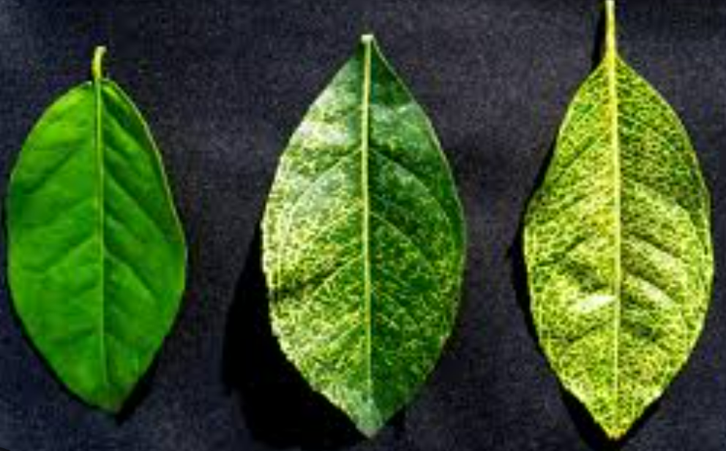
CNN In Crop Identification
Convolutional Neural Network is utilized to identify infected and healthy leaves, as well as to detect illness in affected plants.
It scans the images of crops from left to right and top to bottom and
extracting relevant features from them. Finally it combines all the
features of image classification.
Accurate crop identification can lead to better management decisions, such as optimized irrigation, fertilization, and pest control, ultimately increasing crop productivity and yield.
CNN

Slide 10
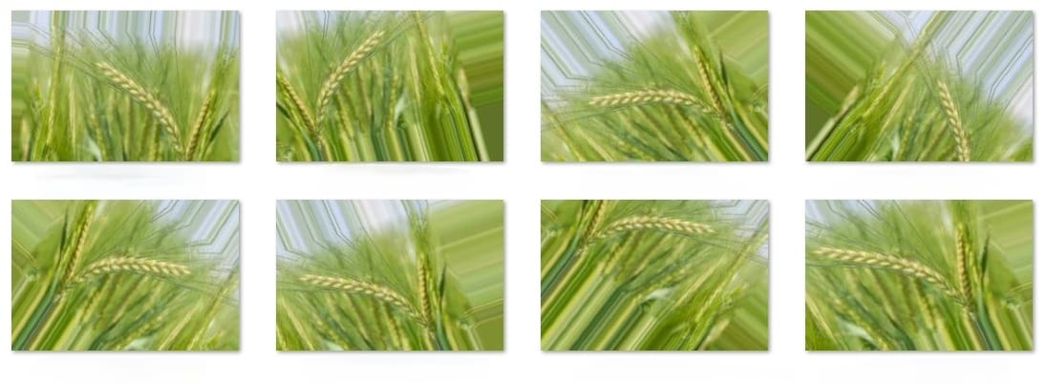
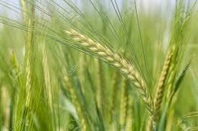
IMAGE AUGMENTATION
Image augmentation is an efficacious technique when we don’t have an ample amount of data for training a deep learning model.
Image augmentation is a technique of altering the existing data to create some more data for the model training process.
The effectiveness of augmentation techniques come from simple transformations such as horizontal flipping, random cropping, and color augmentations.
Original Image
Augmented Images

Slide 11
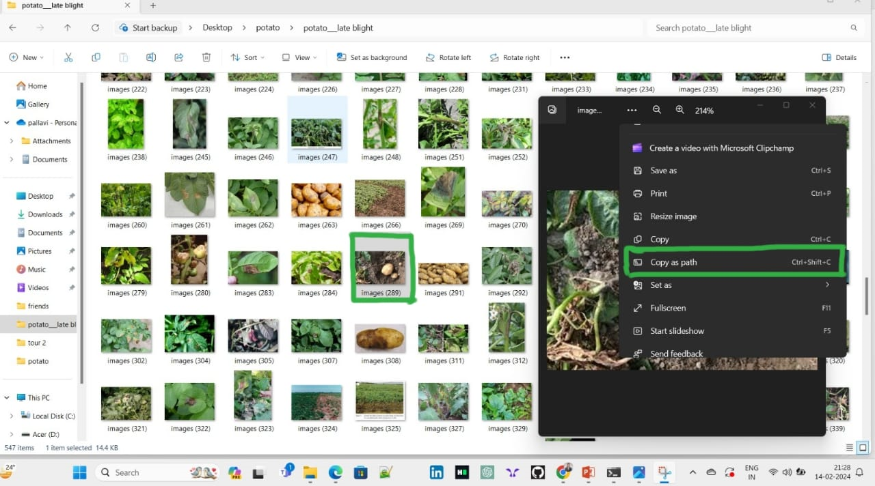
Step 1: Select Image & Copy Path

Slide 12
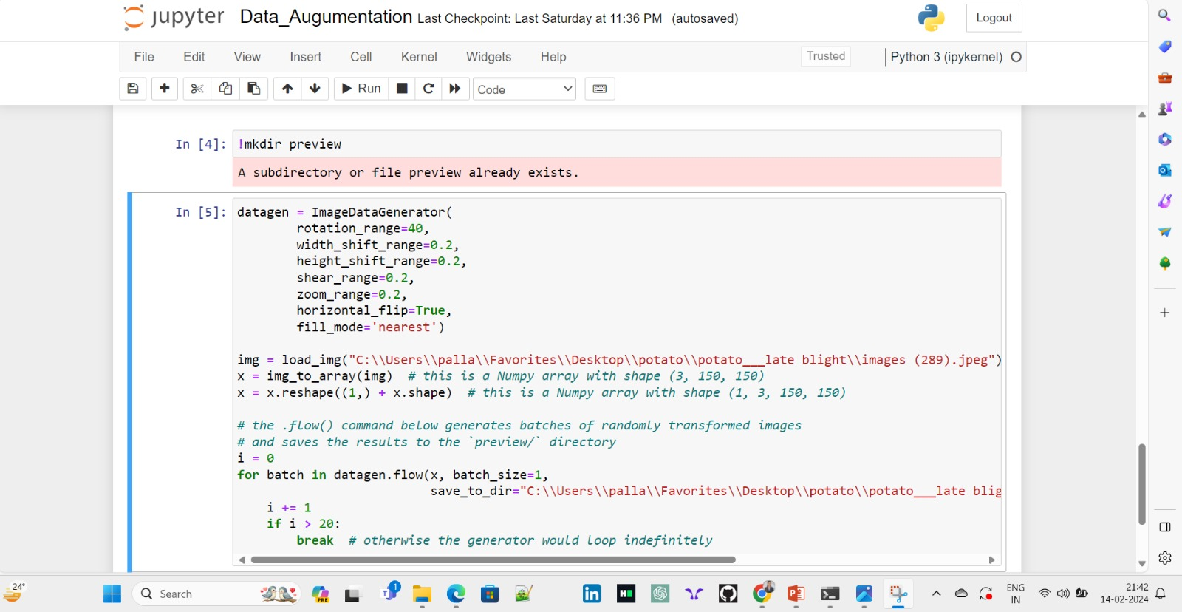
Step 2: Augmentation Process

Slide 13
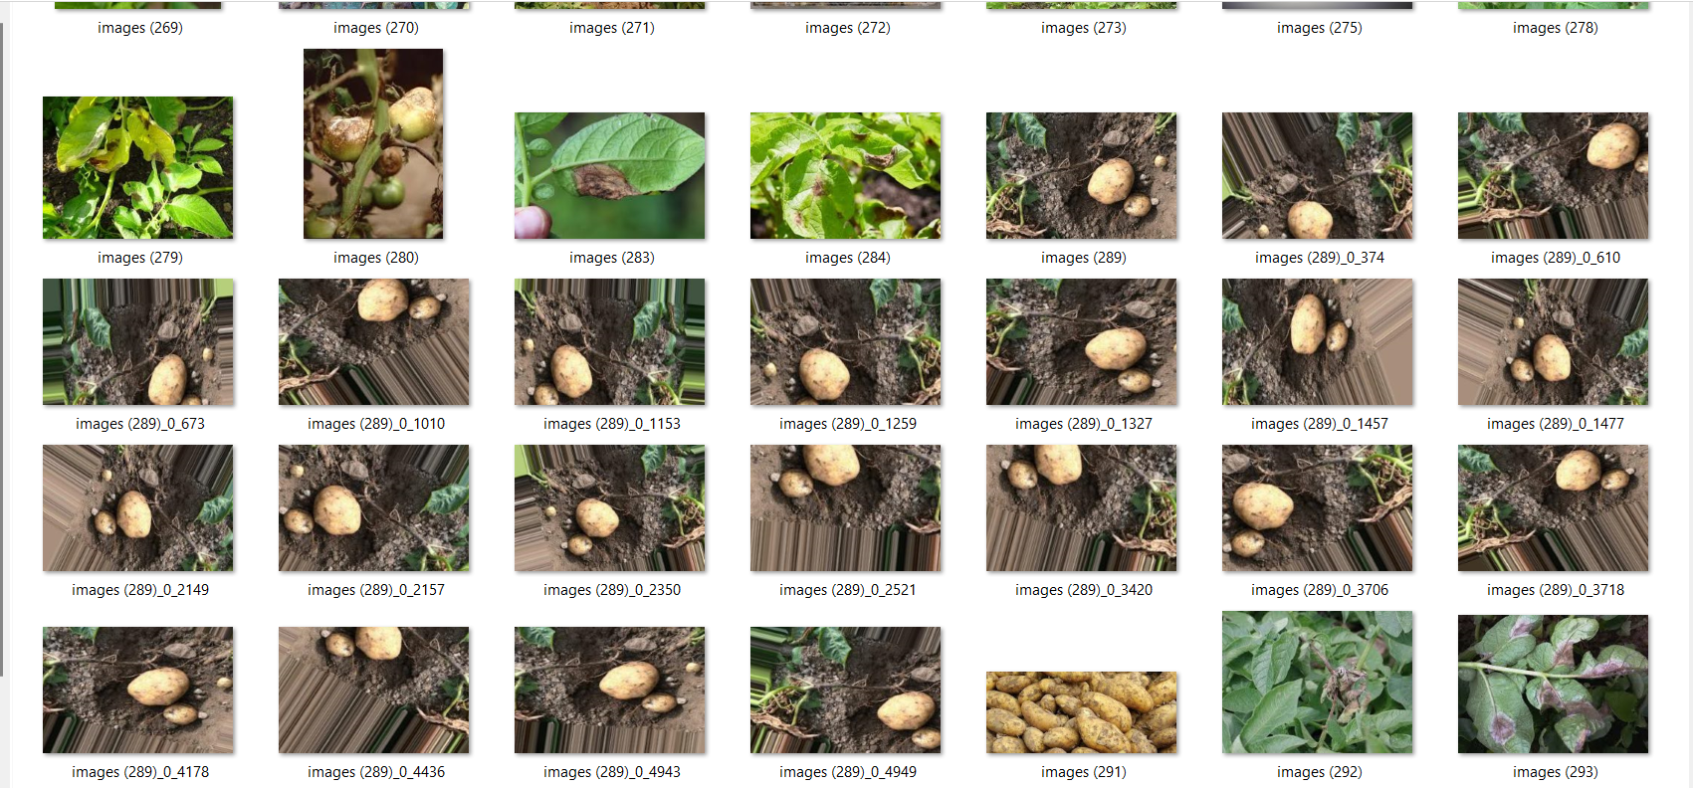
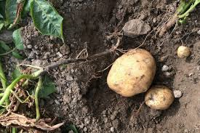
Step 3: Augmentation Results
Before Augmentation
After Augmentation

Slide 14
ADVANTAGES
Early Diseases Detection
Timely intervention
Accessibility for farmers
Crop yield optimization
Global food security

Slide 15
THANK YOU !!!!

